Slide 1


Wei Wang
Feb 17, 2025

Slide 2

Outline
Executive Summary
Introduction
Methodology
Results
Conclusion
Appendix

Slide 3
Executive Summary
Today, SpaceX is considered on of the best companies over the world in terms of space rockets launches, due to the rocket science advancements that achieved in making space missions more affordable and practical, generally space rockets companies offer a rocket launch with a cost of 165 million dollars, whereas SpaceX offers by the same service for only 62 million dollars which considered a huge savings led organizations such NASA to sign contracts with SpaceX.
In this report, I am taking the role of a data scientist working for a new rocket company, called SpaceY that would like to compete with SpaceX founded by Billionaire industrialist Allon Musk. my job is to use data science instead of rocket science to discover the possibility of competing with SpaceX. I am doing this by gathering information about SpaceX, performing data analytics, modeling ML algorithms and creating dashboards for my team

Slide 4
Introduction
Since 1957, the countries around the world are competing to expand beyond Earth, whether through satellites launches or space exploration, these missions require huge amounts of money where a launch of one space rocket costs in average 165 million dollars, a company like Space X changes the equation by reducing this amount of money massively to only 60 million dollars due to its unique and advanced technologies in returning the first stage of rocket structure
As mentioned above one of the key factor of SpaceX’s success in the space race is the first stage of rockets return through a safe landing, from this point we will discover together what are the main attributes or variables that control these successful landings, through asking questions about the nature of the launch process , the payload mass of rocket, launch location, rocket orbit, and more by analyzing and visualizing these information through the data science methodology provided by IBM

Slide 5

Section 1

Slide 6
Methodology
Executive Summary
Data collection methodology:
The data was collected using SpaceX rest API in addition of using data web scraping on Wikipedia webpages
Perform data wrangling
The data was preprocessed using Panadas and NumPy, some of main technique are used: OneHot encoding,
unnecessary columns removal, data normalization and standardization.
Perform exploratory data analysis (EDA) using visualization and SQL
Perform interactive visual analytics using Folium and Plotly Dash
Perform predictive analysis using classification models
Starting with splitting the data into train and test sets
Identifying the best algorithm and parameters through hyperparameters tuning using Grid Search
Adopting the best algorithm and parameters for the purpose of model deployment.

Slide 7
Data Collection
We have collected the data from two main sources:
SpaceX API: Open Source REST API for launch, rocket, core, capsule, starlink, launchpad, and landing pad data.
Wikipedia: is a free online encyclopedia, created and edited by volunteers around the world and hosted by the Wikimedia Foundation
The Process of data collection:
SpaceX API
JSON Format
Pandas Data Frame
Jupyter Notebook on IBM Watson
Wikipedia Web Scraping
TXT Format

Slide 8
Data Collection – SpaceX API
We started the data collection from SpcaeX API by importing the required libraries such as pandas, NumPy and Request, then we established a URL GET request, this request is raised as JSON file to be finally converted to a data frame through choosing the required information like the geospatial info, rocket type, orbit, flight number and more
GitHub URL of the completed SpaceX API calls notebook Link
Data Collection Process from SpaceX API
Jupyter Notebook on IBM Watson
SpaceX API
GET Request
JSON Response
Data Frame

Slide 9
Data Collection – Scraping
As we have done before we start by importing the required Python libraries beautiful soup and request to perform our task, and this time, we have used a webpage on Wikipedia called “Space X Falcon 9 First Stage Landing Prediction” as a data source, then we initialized an HTTP Get Request and the response was as a text format, then we used the beautiful soup library to extract the tables and columns effectively from the text response to be converted later to a pandas' data frame.
GitHub URL of the completed web scrapping task notebook Link
Data Collection via Wikipedia webpage scrapping
Jupyter Notebook on IBM Watson
Wikipedia webpage
GET Request
TEXT Response
Beautiful Soup
Data Frame

Slide 10
Data Wrangling
In this stage we started by importing pandas and NumPy, loading our collected data in the previous stage to perform our exploratory data analysis which aimed to clean the data and choose the valid features for training a machine learning model
GitHub URL of the completed Data wrangling notebook Link
Data Wrangling Stages
1.Loading the collected dataset.
2.Identifying and calculating the percentage of the missing values in each attribute.
3.Identifying which columns are numerical and categorical.
4.Calculating the number of launches on each site.
5.Calculating the number and occurrence of each orbit.
6.Creating a landing outcome label from the Outcome column.
7.Determining the success rate of returning the first stage of the rocket.

Slide 11
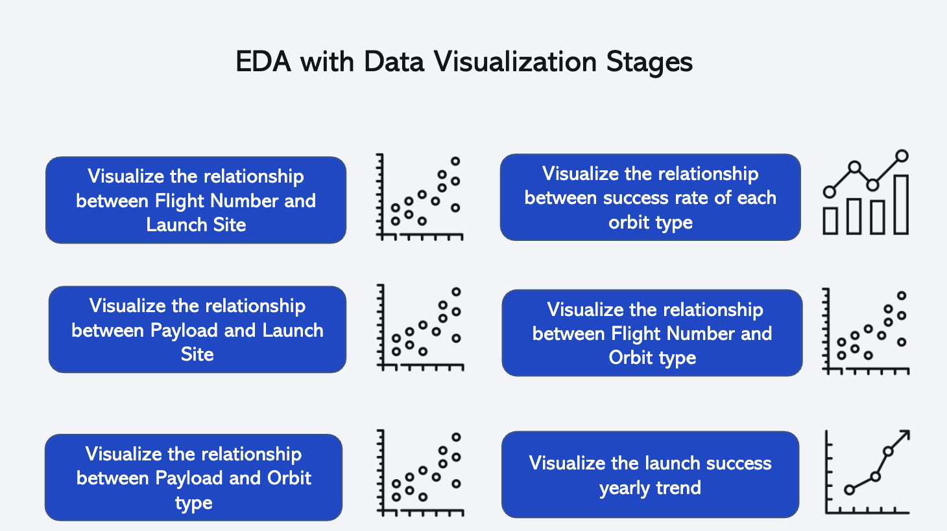
EDA with Data Visualization
In this stage we completed our EDA process through finding the correlation between the features and the target using different visualization tools via seaborn and matplotlib furthermore we have performed feature engineering by converting categorical features into dummy values
GitHub URL of the completed EDA with data visualization notebook, Link

Slide 12
EDA with SQL
SQL Quires
In this stage we used SQL quires as shown on the right to complete our EDA on our collected datase
GitHub URL of the completed EDA with SQL notebook, Link
Display the names of the unique launch sites in the space mission.
Display 5 records where launch sites begin with the string 'CCA’.
Display the total payload mass carried by boosters launched by NASA (CRS).
List the date when the first successful landing outcome in ground pad was achieved.
List the names of the boosters which have success in drone ship and have payload mass greater than 4000 but less than 6000.
List the total number of successful and failure mission outcomes.
List the names of the booster versions which have carried the maximum payload mass. Use a subquery.
List the failed landing outcomes in drone ship, their booster versions, and launch site names for the in year 2015.
Rank the count of landing outcomes (such as Failure (drone ship) or Success (ground pad)) between the date 2010-06- 04 and 2017-03-20, in descending order.

Slide 13
Build an Interactive Map with Folium
Building an Interactive Map with Folium
In this stage we used folium library to represent our work as geospatial data by drawing markers circles and lines on an interactive map.
GitHub URL of the completed interactive map with Folium map notebook, Link
We started our interactive map by drawing 4 circles on 4 different sites belongs to Falcon 9 rockets lunches have the following information:
Launch Site | Lat | Long
CCAFS LC-40 | 28.562302 | -80.577356
CCAFS SLC-40 | 28.563197 | -80.57682
KSC LC-39A | 28.573255 | -80.646895
VAFB SLC-4E | 34.632834 | -120.610746
We put markers to on the same sites to represent the successful/failed first stage of rockets return using marker objects :
Finally, we calculated the distances between the launch site (CCAFS LC-40) to its proximities 1-the closest city, 2-coastline, and 3-highway. Then we drew polylines to represent these distances using PolyLine object

Slide 14
Build a Dashboard with Plotly Dash
Building an Interactive Dashboard with Plotly Dash
1- We added a dropdown list to enable Launch Site selection including the following options:
All Sites, CCAFS LC-40, CCAFS SLC-40, VAFB SLC-4E, KSC LC-39A
2- we added a pie chart to show the total successful launches count for all sites
3- we added a slider to select payload which ranges from 0 -10000
4- finally we added a scatter chart to show the correlation between payload and launch succes
GitHub URL of the completed Building an Interactive Dashboard with Plotly Dash notebook, Link

Slide 15
Predictive Analysis (Classification)
Machine Learning Pipelines
Machine Learning Stages:
1- Importing the required libraries.
2- Loading the cleaned data.
3- Standardizing the data to prevent the bias.
4- splitting the data into 20% for testing data and 80% training data.
5- Initializing 4 different classification algorithms:
Logistic Regression (LR)
Support Vector Machine (SVM)
Decision Tree (DT)
K nearest neighbors (KNN)
6- Using Grid Search technique to find the best parameters
7- Using Evaluation techniques including, Confusion matrix ,
F1 score, Jaccard Score for the purpose of using the best model among the algorithms abov
Link
Importing The Required Libraries
Loading the cleaned data
Standardizing the data
Using Grid Search technique
Initializing classification algorithms
Splitting the data into Test/Train sets
Using Evaluation techniques
Identifying The best model and parameters

Slide 16
Results
Exploratory data analysis results
Interactive analytics demo in screenshots
Predictive analysis results

Slide 17

Section 2

Slide 18
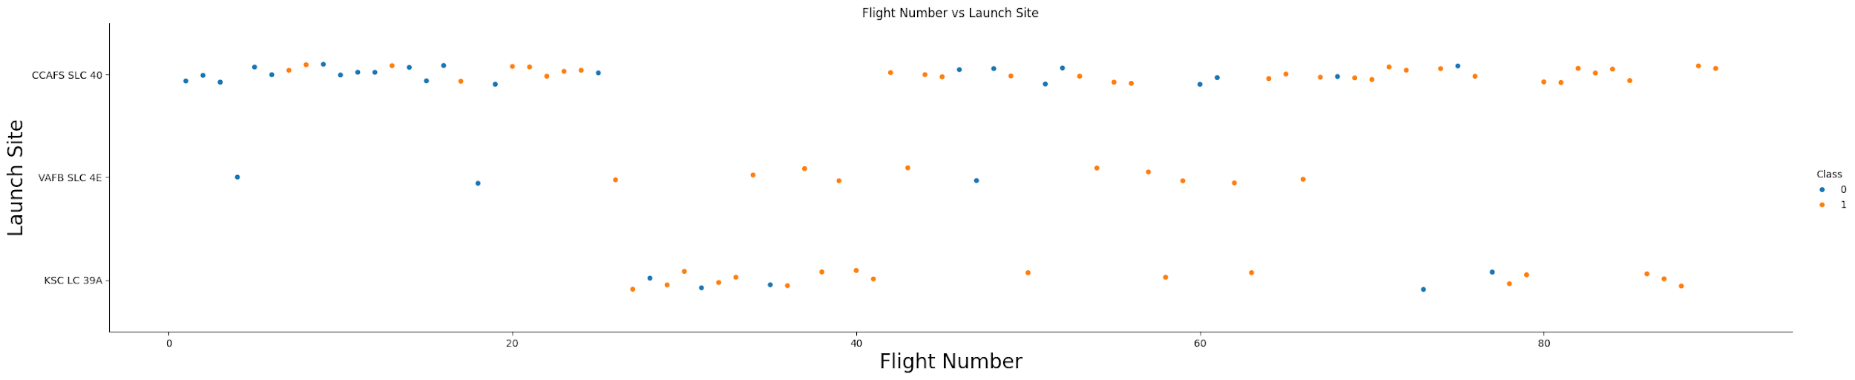
Flight Number vs. Launch Site
1- CCAFS SLC 40 : is the most usable site for launching SpaceX's rockets and it has 55 trials, 33 of them are successful and 22 of them are failed # 60% success rate
2- VAFB SLC 4E : is the least usable site for launching SpaceX's rockets and it has 13 trials, 10 of them are successful and 03 of them are failed # 77% success rate
3- VAFB SLC 4E : is a moderate site in terms of launching SpaceX's rockets and it has 22 trials, 17 of them are successful and 05 of them are failed # 77% success rate

Slide 19
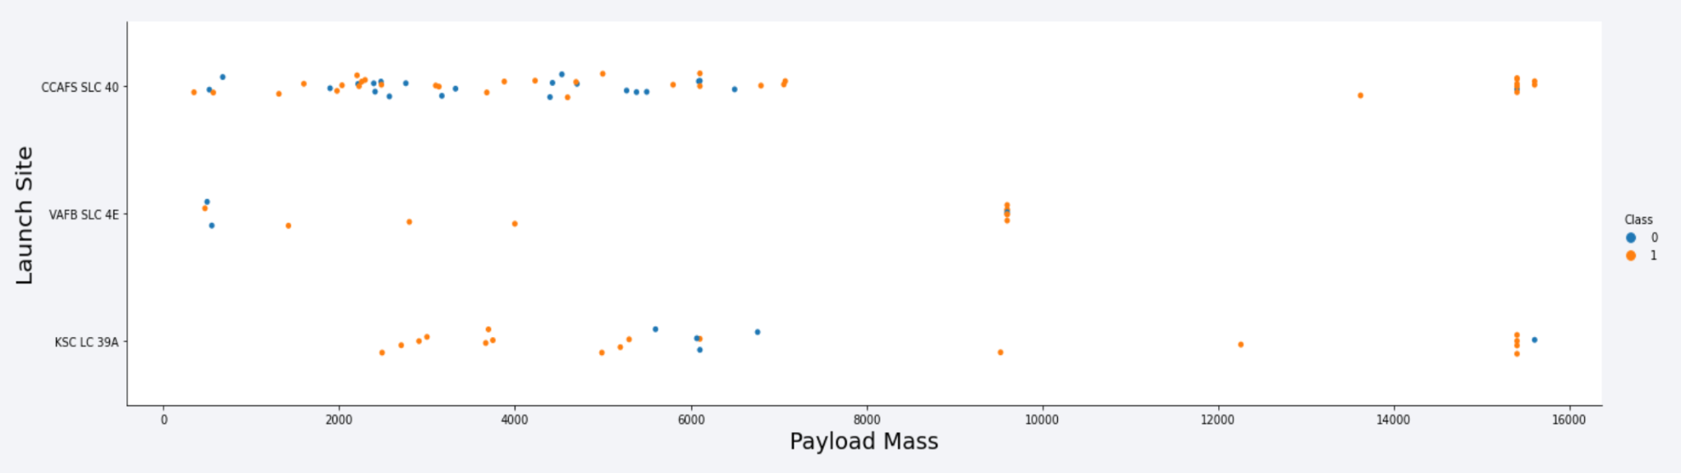
Payload vs. Launch Site
According to the plot above:
there is no strong relationship between the payload mass and the success of first stage return since there are approximately equivalent numbers of failed and successful trials.

Slide 20
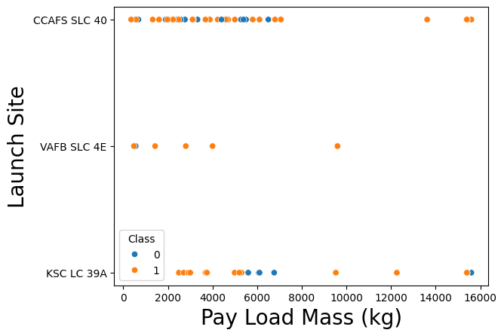
Payload vs. Launch Site
CCAFS SLC 40 and KSC LC 39A have a wider range of payload masses compared to VAFB SLC 4E.
VAFB SLC 4E has fewer launches and generally handles lower payload masses
Successful landings (Class 1, orange dots) occur across all payload masses at CCAFS SLC 40 and KSC LC 39A.
VAFB SLC 4E shows fewer data points, but successful landings are present, with no rockets launched for heavy payload mass (greater than 10000)

Slide 21
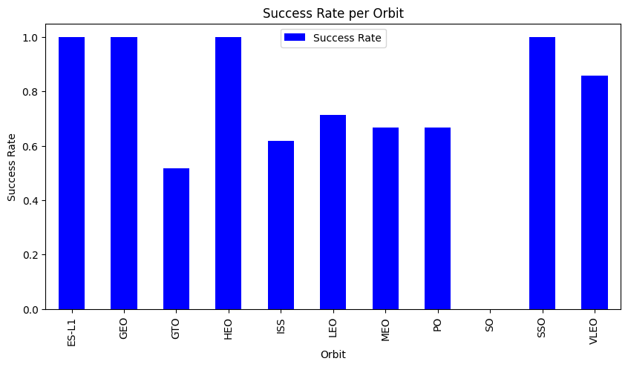
Success Rate vs. Orbit Type
According to the bar plot :
The best orbits in terms of successful first stage returns are ['ES-L1', 'GEO', HEO, SSO]
Where the worst orbit is 'GTO’ , therefore we need to understand why it is the worst to avoid the failure of first stage return

Slide 22
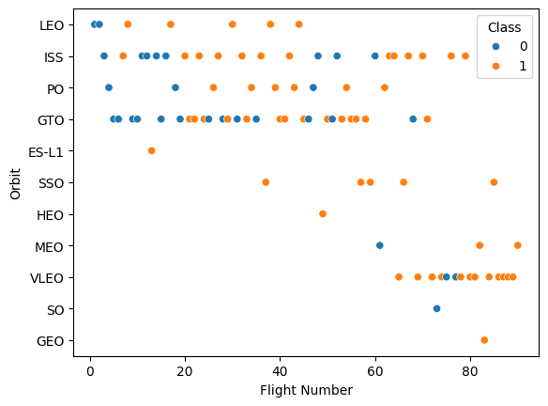
Flight Number vs. Orbit Type
As the flight number increases, indicating more recent launches, there is a trend towards more successful landings (Class 1, orange dots).
Some orbits, like ES-L1, SSO, and GEO, show a higher concentration of successful landings.
LEO and ISS have a mix of successful and unsuccessful landings, with a slight increase in success over time.
GTO shows a more balanced mix of outcomes, indicating challenges in achieving consistent success.

Slide 23
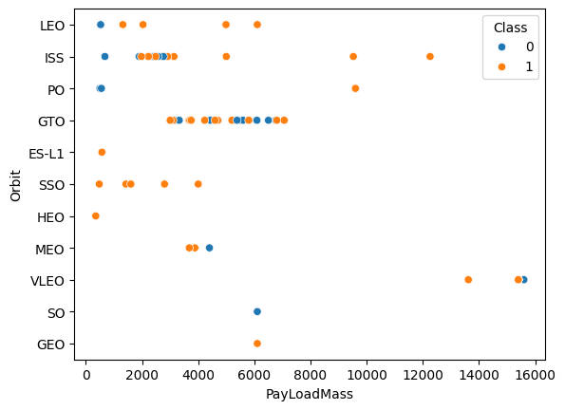
Payload vs. Orbit Type
GTO orbit shows a concentration of payloads around 6000 kg, with mixed success.
LEO and ISS orbits handle a wide range of payload masses, with many successful landings (Class 1, orange dots).
Higher payload masses, especially in VLEO and GEO, tend to have successful outcomes.

Slide 24
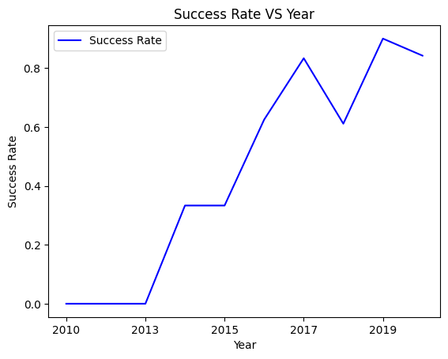
Launch Success Yearly Trend
The yearly launch success rate since 2013 kept increasing till 2017, then there was a fluctuation in 2018
From 2019 to 2020, the success rate rebounded to above 80%
Overall, Lauch success rates has significantly improved over the years.

Slide 25
All Launch Site Names
The unique launch sites in the SpaceX dataset are:
CCAFS SLC 40: Cape Canaveral Air Force Station Space Launch Complex 40.
VAFB SLC 4E: Vandenberg Air Force Base Space Launch Complex 4E.
KSC LC 39A: Kennedy Space Center Launch Complex 39A.
CCAFS SLC 40 and CCAFS LC 40 are the same. This needs data cleaning to merge the two.

Slide 26
Launch Site Names Begin with 'CCA'
The Launch Site beginning with "CCA," is CCAFS LC-40 (Cape Canaveral Air Force Station Launch Complex 40).
All entries use the Falcon 9 v1.0 booster, indicating early missions in the Falcon 9 program.

Slide 27
Total Payload Mass
The total payload mass carried by boosters launched by NASA (CRS) is 45596 kilograms

Slide 28
Average Payload Mass by F9 v1.1
The average payload mass carried by booster version F9 v1.1 is 2534.67 Kilograms

Slide 29
First Successful Ground Landing Date
The first date of successful landing outcome on ground pad was December 22, 2015

Slide 30
Successful Drone Ship Landing with Payload between 4000 and 6000
The names of boosters which have successfully landed on drone ship and had payload mass greater than 4000 but less than 6000 were
F9 FT B1022 F9 FT B1026 F9 FT B1021.2 F9 FT B1031.2

Slide 31
Total Number of Successful and Failure Mission Outcomes
The total number of successful and failure mission outcomes were
With data cleaning, all successes were merged to obtain 100 successes.
Mission Outcome | Total Outcome
Failure | 1
Success | 100

Slide 32
Boosters Carried Maximum Payload
The names of the booster which have carried the maximum payload mass were
Booster Version
F9 B5 B1048.4
F9 B5 B1049.4
F9 B5 B1051.3
F9 B5 B1056.4
F9 B5 B1048.5
F9 B5 B1051.4
F9 B5 B1049.5
F9 B5 B1060.2
F9 B5 B1058.3
F9 B5 B1051.6
F9 B5 B1060.3
F9 B5 B1049.7
All boosters with sub versions of F9 B5

Slide 33
2015 Launch Records
The failed landing outcomes in drone ship, with their booster versions, and launch site names for in year 2015
The launches occurred in January (01) and April (04).
Both launches took place at CCAFS LC-40 (Cape Canaveral Air Force Station Launch Complex 40).
The booster versions used were F9 v1.1 B1012 and F9 v1.1 B1015, both part of the Falcon 9 v1.1 series.
Month | Landing Outcome | Booster Version | Launch Site
01 | Failure (drone ship) | F9 v1.1 B1012 | CCAFS LC-40
04 | Failure (drone ship) | F9 v1.1 B1015 | CCAFS LC-40

Slide 34
Rank Landing Outcomes Between 2010-06-04 and 2017-03-20
The Rank of landing outcomes between the date 2010-06-04 and 2017-03-20, are
Landing Outcome | Total Outcomes
Controlled (ocean) | 3
Failure (drone ship) | 5
Failure (parachute) | 2
No attempt | 10
Precluded (drone ship) | 1
Success (drone ship) | 5
Success (ground pad) | 3
Uncontrolled (ocean) | 2

Slide 35

Section 3

Slide 36
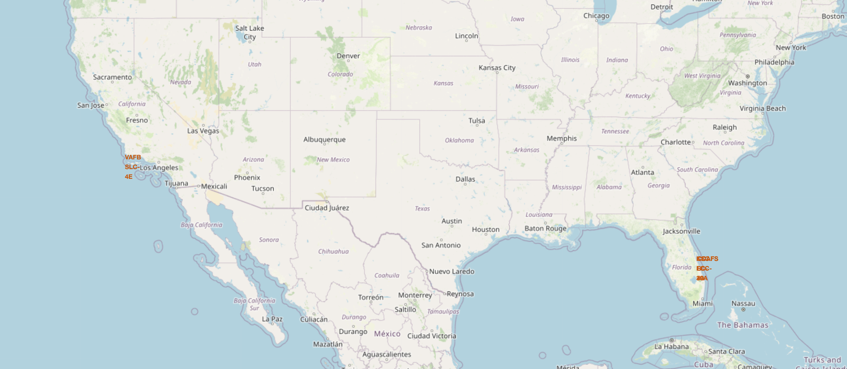
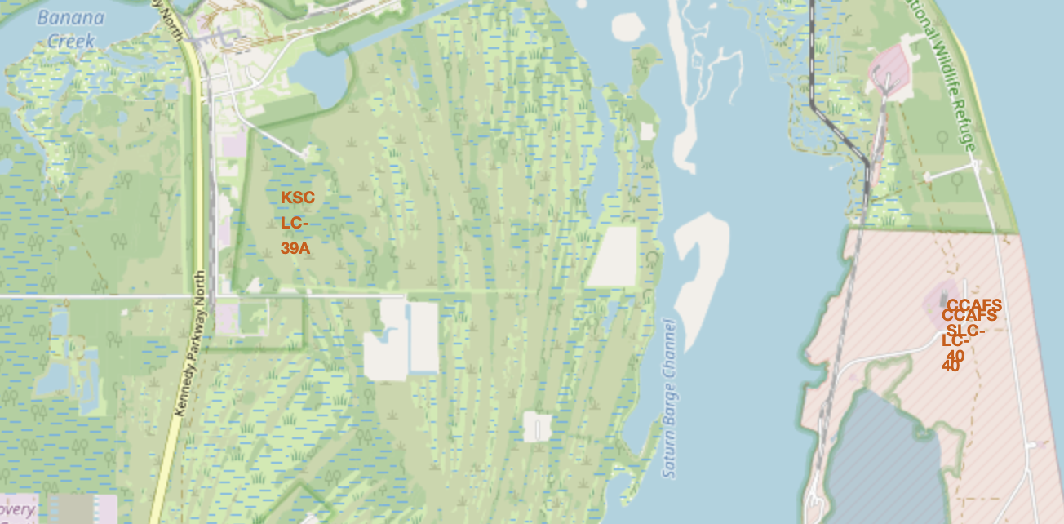
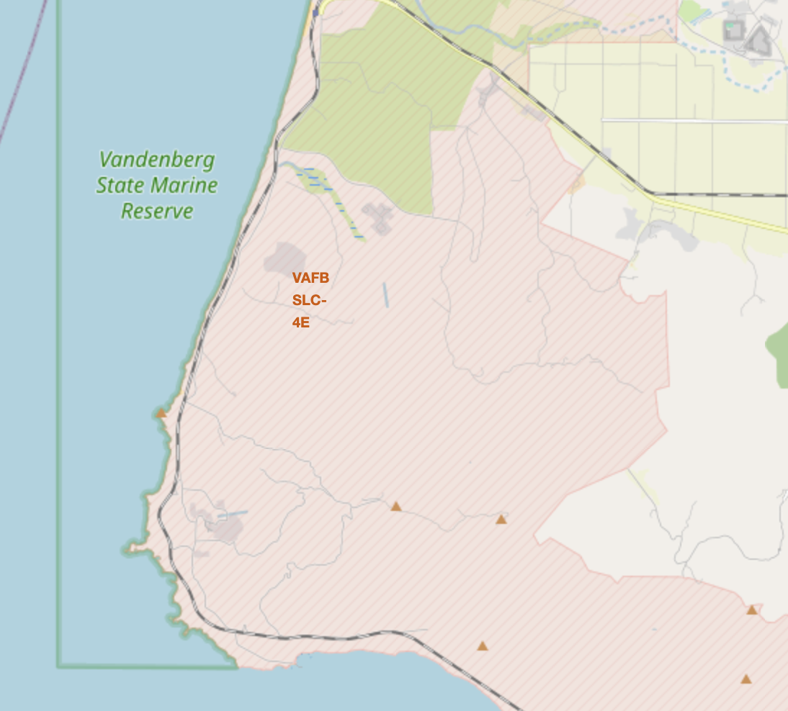
Launch Sites on the US Map
Labeling of Launch sites on the east and west coasts of the USA

Slide 37
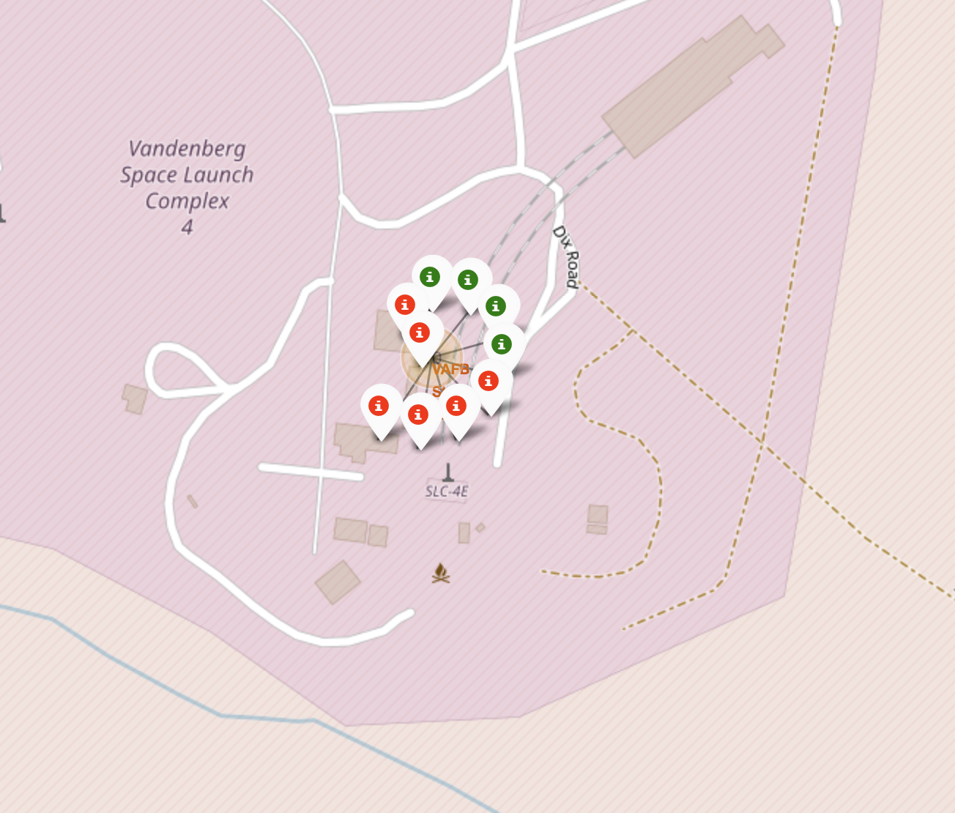
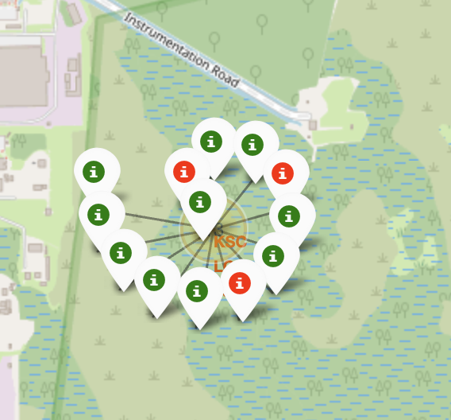
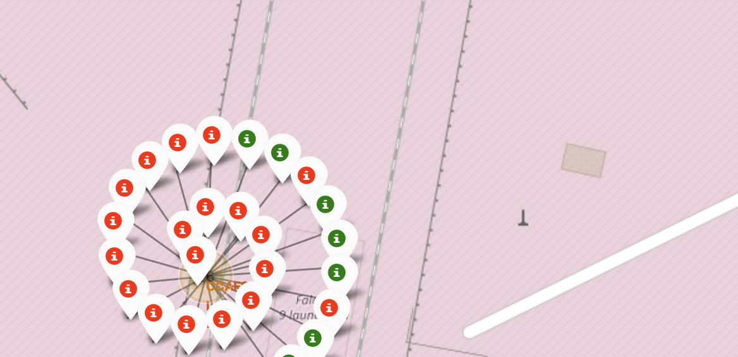
Launch site outcomes
Successful outcome at the various launch sites are labeled in green with a marker, or red for failure outcomes.
This help identifies which specific spots at the Launch sites are more likely to have a good successful outcome, all other things being equal.

Slide 38
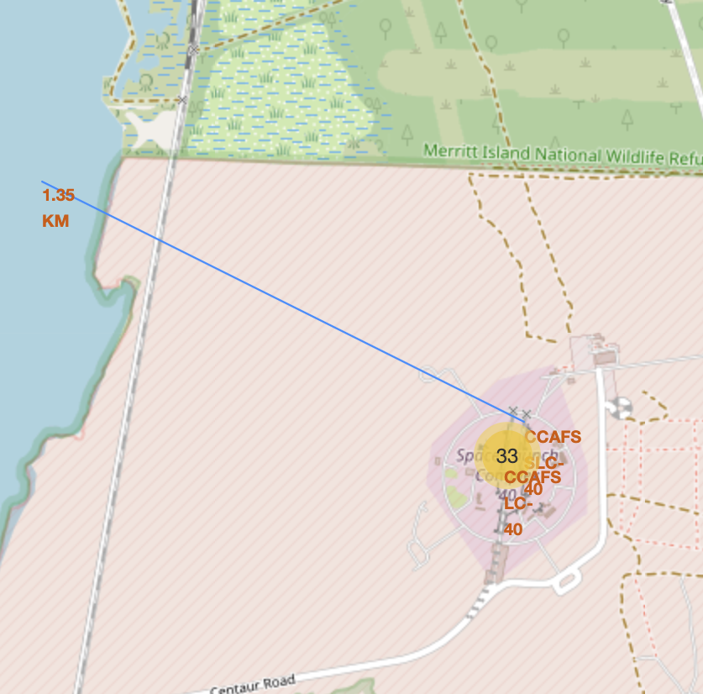
Launch Site proximity to Points of Interest
A polyline drawn from the launch site to coastal area showing a distance of 1.35 Kilometers

Slide 39

Section 4

Slide 40
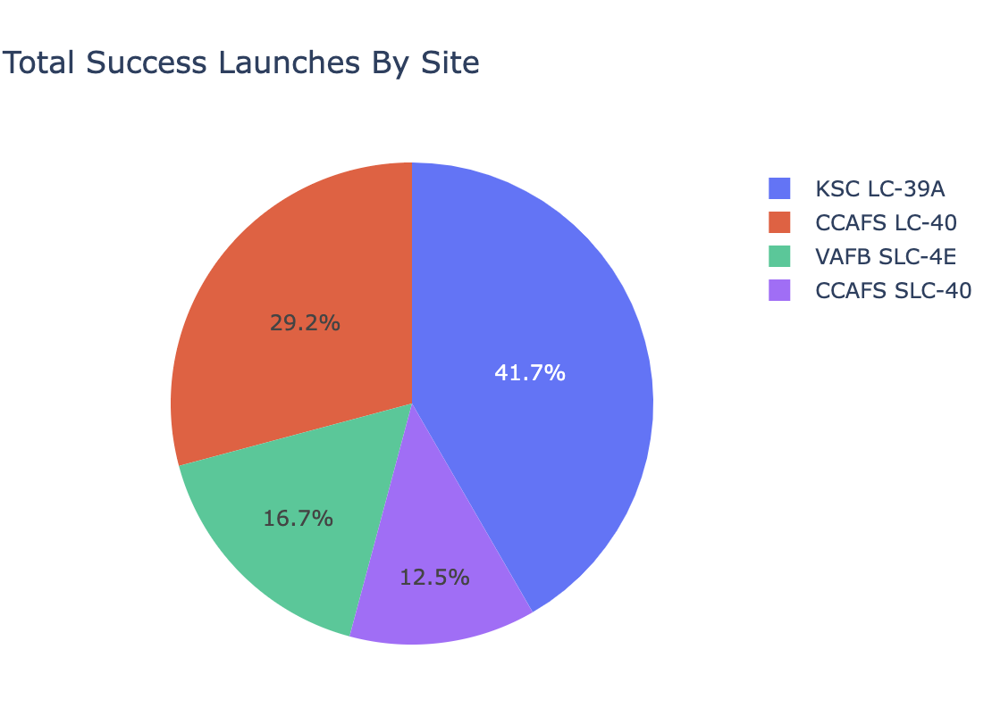
Launch Success counts per launch site
The pie chart shows that KSC LC-39 has the greatest share of successes (41.7%), followed by CCAFS LC-40 with 29.2 %

Slide 41
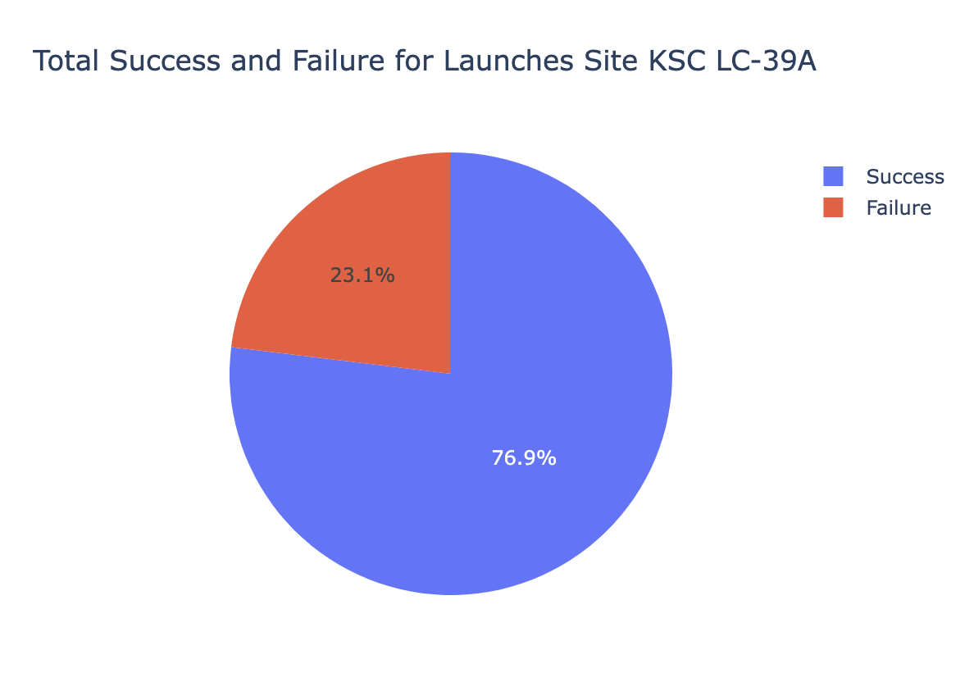
Outcome Ratio for KSC LC-39 Launch Site
The KSC LC-39 has 76.9% success in all rocket launches

Slide 42
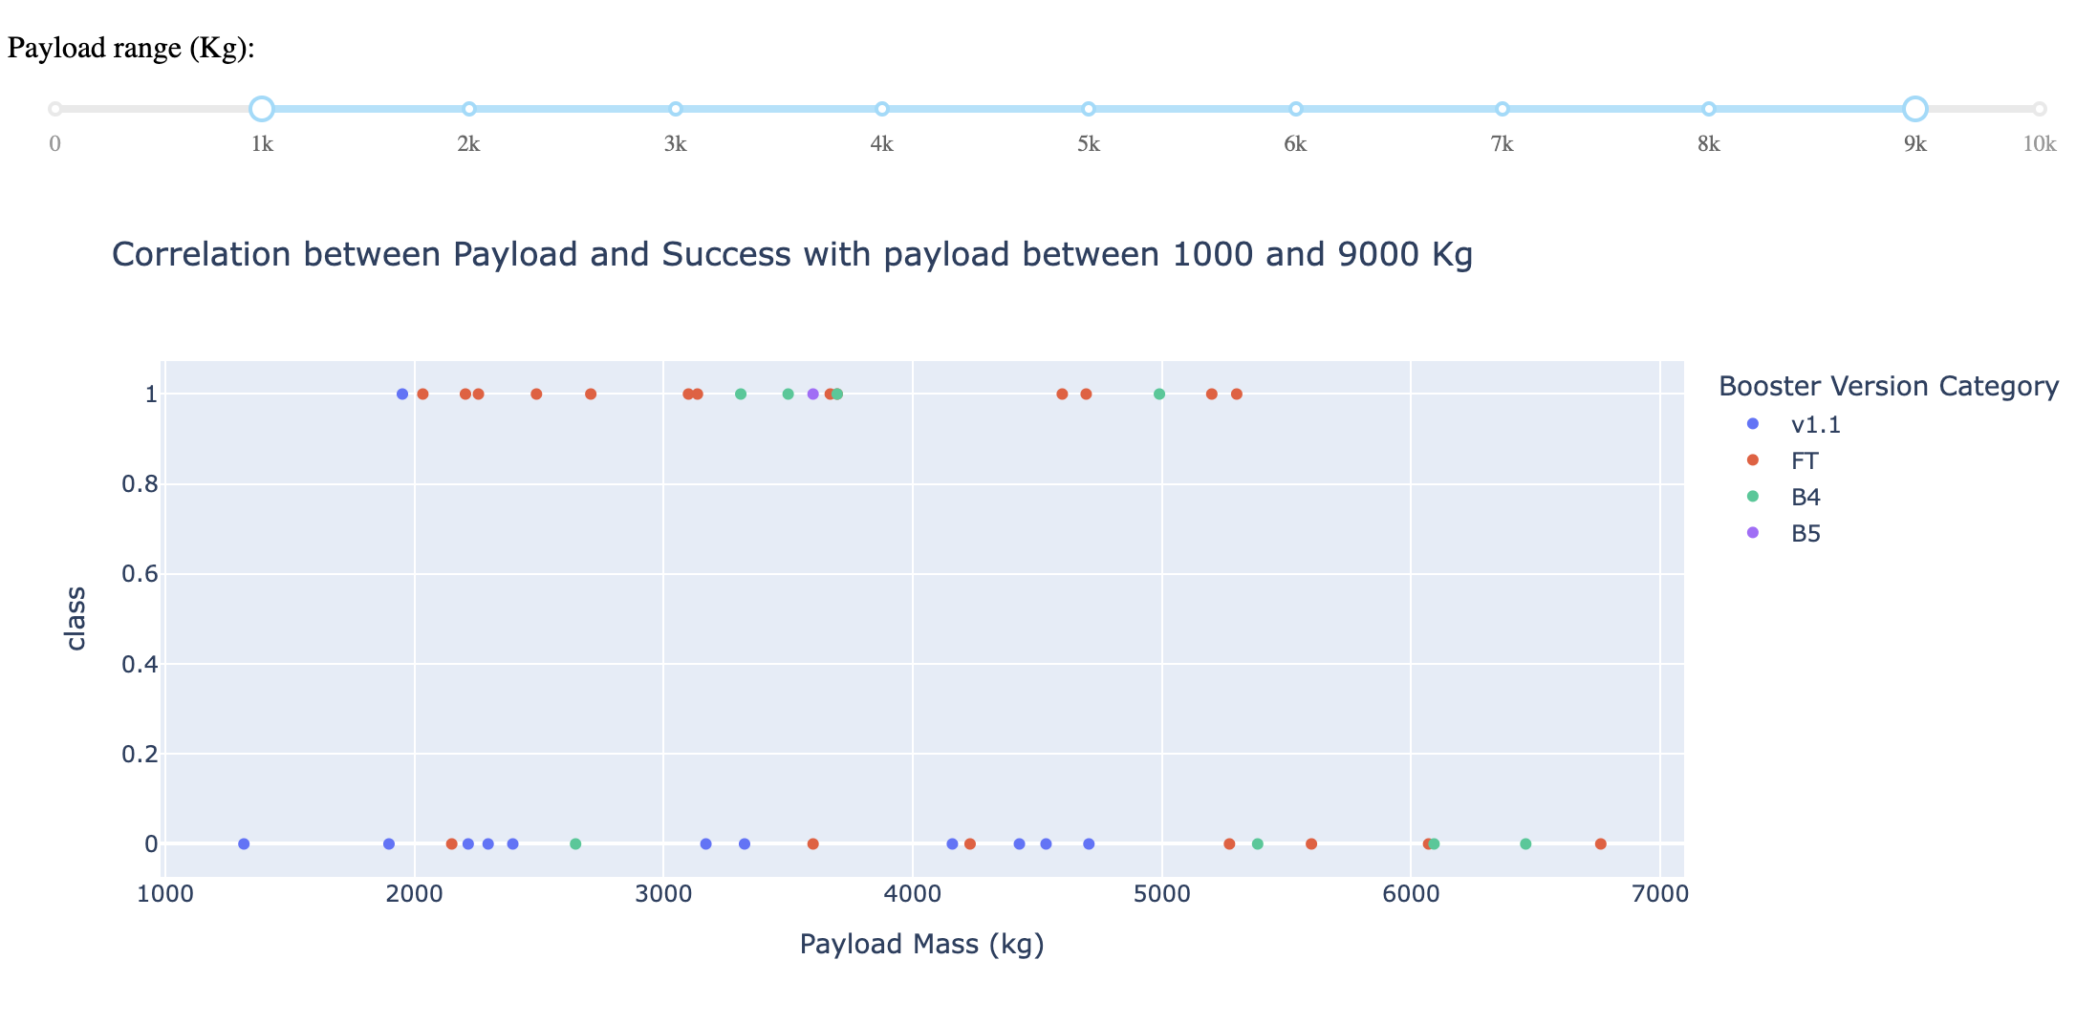
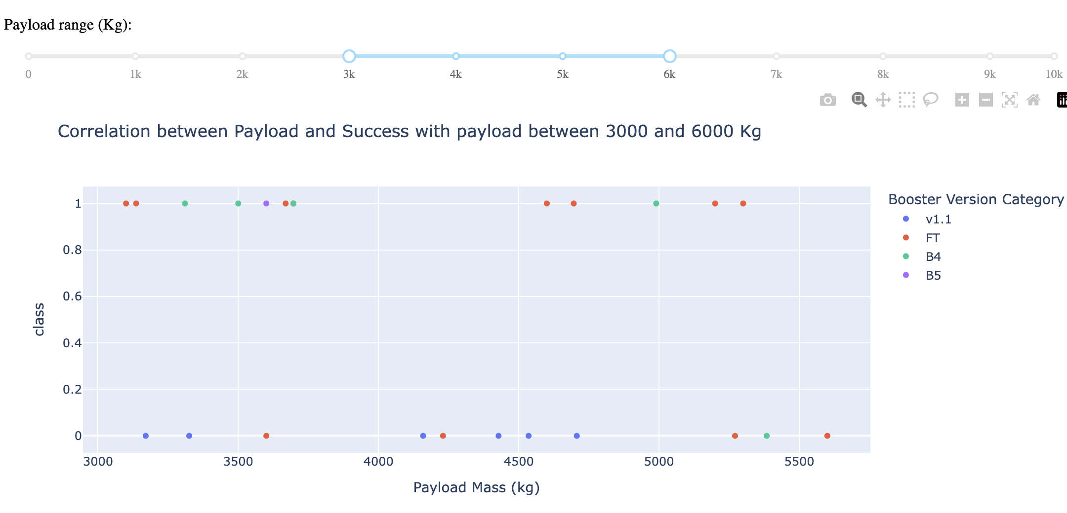
Payload vs Launch Outcomes
Payload range slider allows users to select a range of payload masses (in kg) to filter the data displayed in the scatter plot.
The plots show data for different payload ranges, such as 3000-6000 kg and 1000-9000 kg
The success and failure rate can be observed across all payload ranges

Slide 43

Section 5

Slide 44
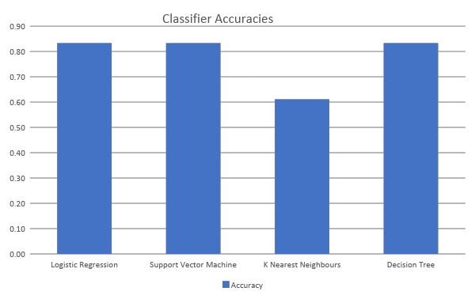
Classification Accuracy
Logistic Regression, Support Vector Machine, and Decision Tree had the best accuracy of 83.33%
K-Nearest Neighbors classifier had the least accuracy with 61 %

Slide 45

Confusion Matrix
True Positives (TP) : The model correctly predicted 12 instances where the first stage landed.
True Negatives (TN) : The model correctly predicted 3 instances where the first stage did not land.
False Positives (FP): The model incorrectly predicted 3 instances as landed when they did not land (Type I error).
False Negatives (FN): The model did not have any instances where it failed to predict a landing when it actually landed (Type II error).
Overall, the model performs well with an accuracy of approximately 83.3%, but there is room for improvement in reducing false positives.

Slide 46
Conclusions
SpaceX's Falcon 9 rocket offers launch services at a significantly lower cost ($62 million) compared to traditional providers ($165 million+), primarily due to the reusability of the rocket's first stage, provided it lands successfully.
The project aimed to identify patterns and trends in landing outcomes through exploratory data analysis (EDA), interactive visualizations, and machine learning techniques. Key findings included:
Increased Landing Success Over Time: There has been a notable improvement in successful landings in recent years, especially from launch sites CCAFS SLC 40 and KSC LC 39A.
Influence of Target Orbits: Missions to orbits such as ES-L1, GEO, HEO, and SSO exhibited higher landing success rates. In contrast, missions targeting GTO and SO faced more challenges.
Predictive Modeling: A machine learning model was developed, achieving an 83% accuracy rate in predicting successful landings. Nonetheless, there is potential to enhance the model's performance, particularly in reducing false positive predictions.
The find of will help SpaceX in strategizing launches for successful outcomes. Additional research is needed to improve the findings of this project.

Slide 47
Appendix
The code, notebooks and data for the project can be download on GitHub at https://github.com/randgua/ibm-data-science-professional-certificate

Slide 48


